Slide 1
Advanced Python Libraries NumPy, Pandas & Matplotlib
Mini Project on Basic Data Analysis Presented by: Om mistry(2401030730001) Branch: Cse(Cyber security) semester: 4

Slide 2

What Are Python Libraries?
Python libraries are collections of pre-written code.
They help perform tasks easily and efficiently.
Useful for data analysis, visualization, machine learning, etc.
Libraries save time and reduce coding effort.
In this project, we use NumPy, Pandas, and Matplotlib.

Slide 3
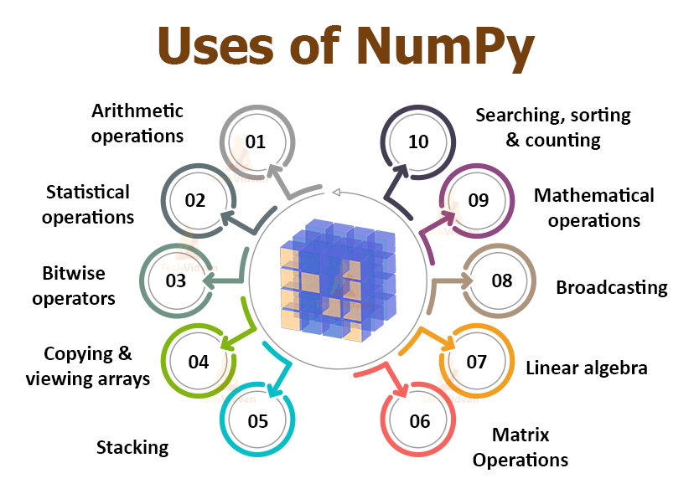
Introduction to NumPy
NumPy = Numerical Python
Offers support for arrays and mathematical operations.
Super fast and efficient for numerical data.
Core feature: ndarray (n-dimensional array)

Slide 4
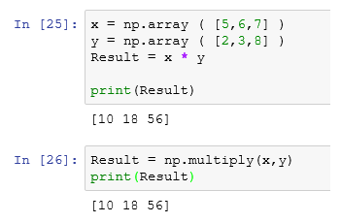
Basic NumPy Example

Slide 5
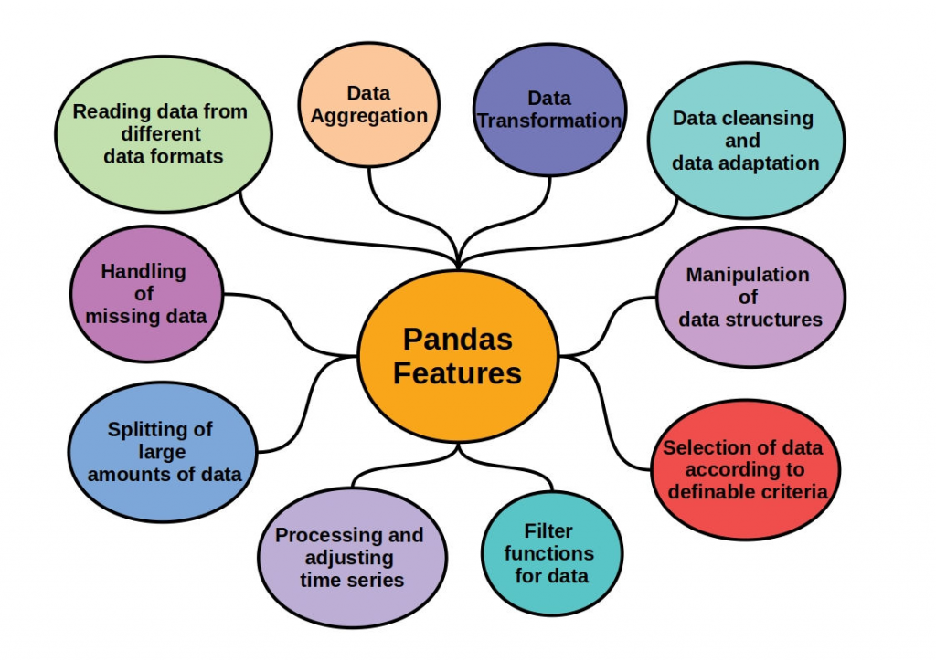
Introduction to Pandas
Pandas is used for data manipulation and analysis.
Works with Series (1D) and DataFrames (2D).
Ideal for working with tabular (CSV) data.
Simplifies data cleaning, filtering, and transformation.

Slide 6
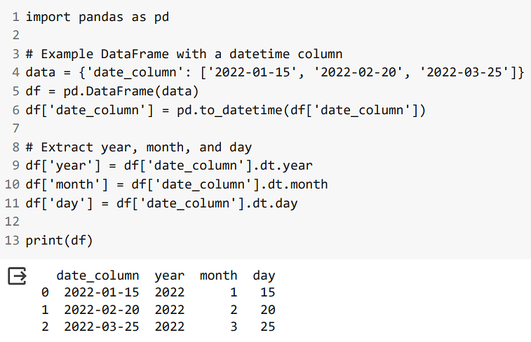
Basic Pandas Example

Slide 7
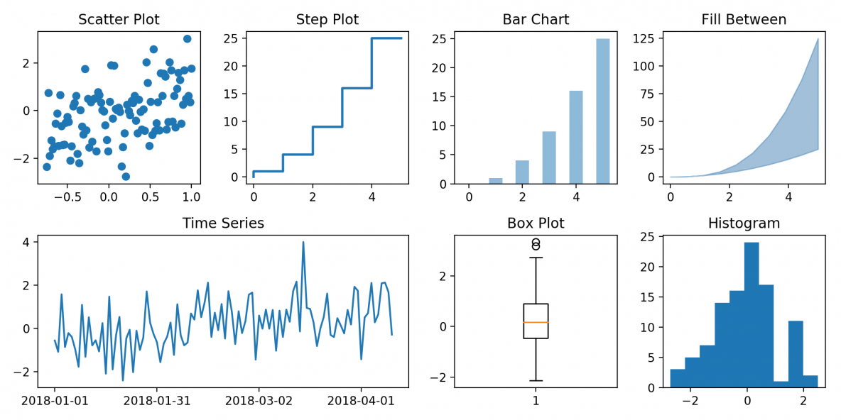
Introduction to Matplotlib
Matplotlib is a powerful Python library for data visualization.
It helps you create graphs and charts like line plots, bar graphs, pie charts, and more.
Works well with NumPy and Pandas for visualizing data.
Helps to understand data patterns and trends easily.
Commonly used in data science, research, and reports.

Slide 8
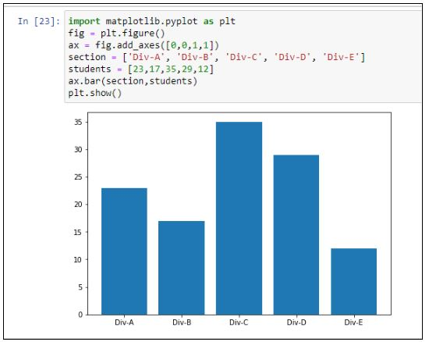
Basic Matplotlib Example

Slide 9
Mini Project Overview
Project Title: Top Tourist States in India – 2023
Objective: Analyze and visualize the number of domestic and foreign tourists visiting top Indian states in 2023.
Libraries Used: Pandas, Matplotlib
Dataset: Visitor numbers for Indian states in 2023 (sourced from the official India Tourism Statistics 2023)
Goal: Create a bar chart to compare state-wise tourism.

Slide 10
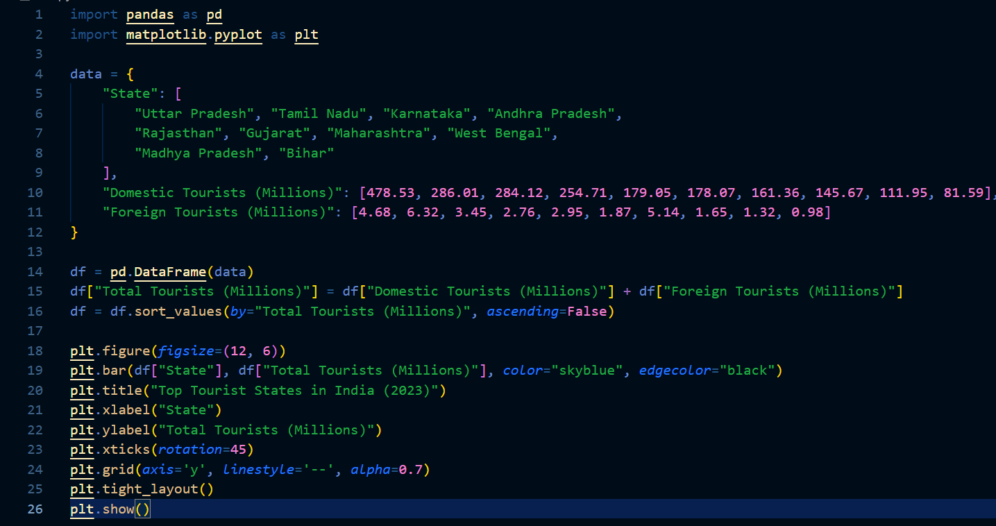
Code snippet

Slide 11
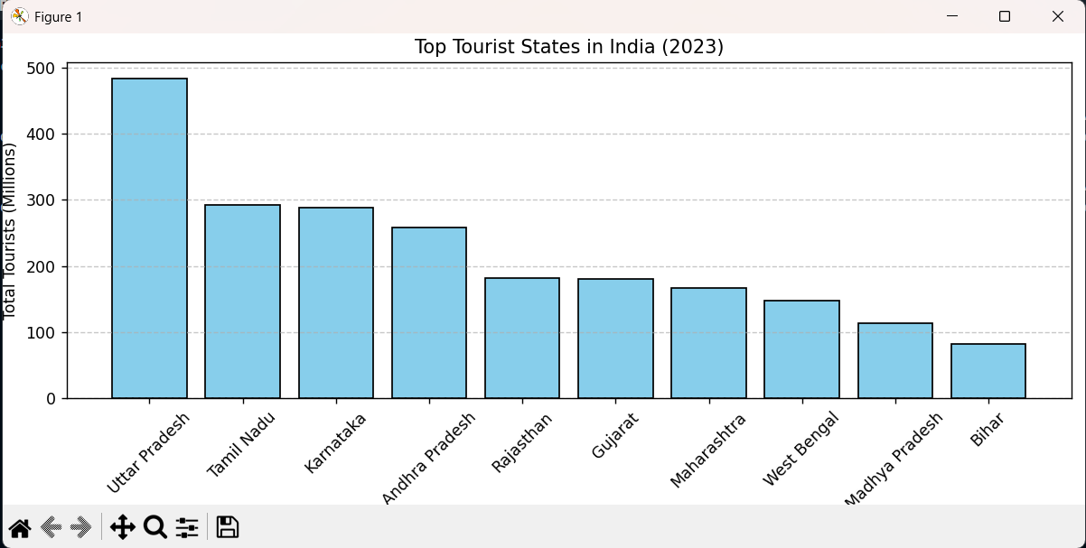
Output Graph

Slide 12
Thank You!
“Feel free to explore the code and provide feedback.”
GitHub Repo: https://github.com/OMMISTRY197/top_tourist_states_in_india_2023

